Slide 1

Forecasting Chicago
Crime Cases
ADSP 31006 | TMG Team
Haoyu Zhang
Marian Xu
Yifan Han
Liuyi Pan

Slide 2




Meet Our Team
Haoyu Zhang
Yifan Han
Liuyi Pan
Marian Xu

Slide 3
Agenda
01
02
03
04
Introduction
EDA
Data modeling
Future Steps

Slide 4
Business Problem
Problem Statement:
The city of Chicago has experienced fluctuating crime rates over the years, posing significant challenges to public safety and resource allocation. Accurate forecasting of crime trends is crucial for policymakers and law enforcement agencies to implement effective crime prevention strategies and allocate resources efficiently.
Objective:
The primary objective of this project is to develop a predictive model for forecasting the monthly total number of crime cases in Chicago.

Slide 5
Data Overview
Primary：
Features:
ID, Case Number, Date, Block, IUCR, Primary Type, Description, Location Description, Arrest, Domestic, Beat, District, Ward, Community Area, FBI Code, X Coordinate, Y Coordinate, Year, Updated On, Latitude, Longitude, Location
Chicago Crime Data
Jan 2001 - Mar 2023
(https://data.cityofchicago.org/Public-Safety/Crimes-2001-to-Present/ijzp-q8t2/about_data)
Additional：
Features:
Date, Unemployment Rate
U.S. Unemployment Rate Data
Jan 2001 - Mar 2023
(https://data.bls.gov/cgi-bin/surveymost#/)

Slide 6
Data Processing
Initial Data Cleaning (Feature Engineering)
Selection of Key Columns: Focus on essential columns: Case Number(ID), Date, Primary Type.
Aggregation by Date: Group data by month and calculate the total number of distinct crime cases and also different case types to monitor trends over time.
Data Splitting
Train Set: January 2001 to December 2021
Test Set: January 2022 to December 2022
Date | Total Cases | Theft Cases | Burglary Cases | Motor vehicle Theft Cases | …(total of 33 types)
Jan-01 | 38119 | 7867 | 1934 | 2097 | …
Feb-01 | 33784 | 6669 | 1666 | 1785 | …
Mar-01 | 40565 | 7766 | 1832 | 2151 | …
Apr-01 | 40088 | 7702 | 1932 | 2119 | …
May-01 | 41836 | 8420 | 1997 | 2197 | …
First Five Row of Cleaned Data

Slide 7
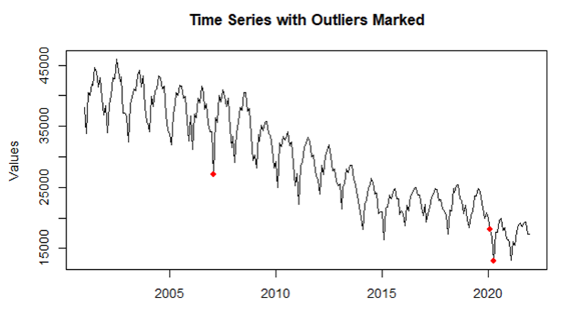
Data Processing
Anomaly Detection
Outliers: opted to retain these outliers to preserve the complete integrity of the data.
2007.2
Cold Winter Effect
2020.2, 2020.4
Cold Winter +
COVID-19 Effect
Notes:
We believe the existence of outliers is reasonable, reflecting genuine variations in the dataset.

Slide 8
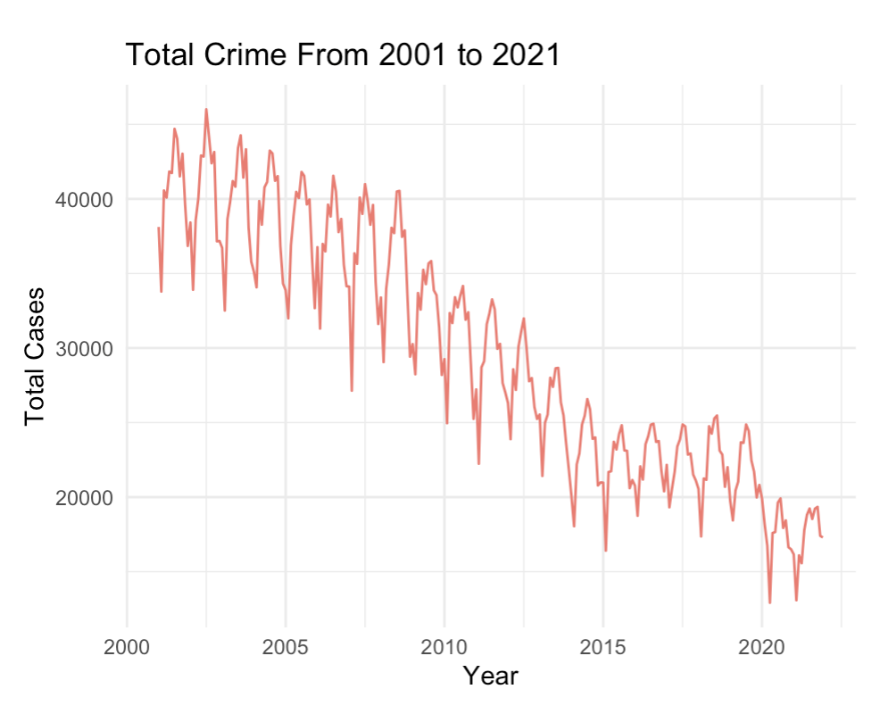
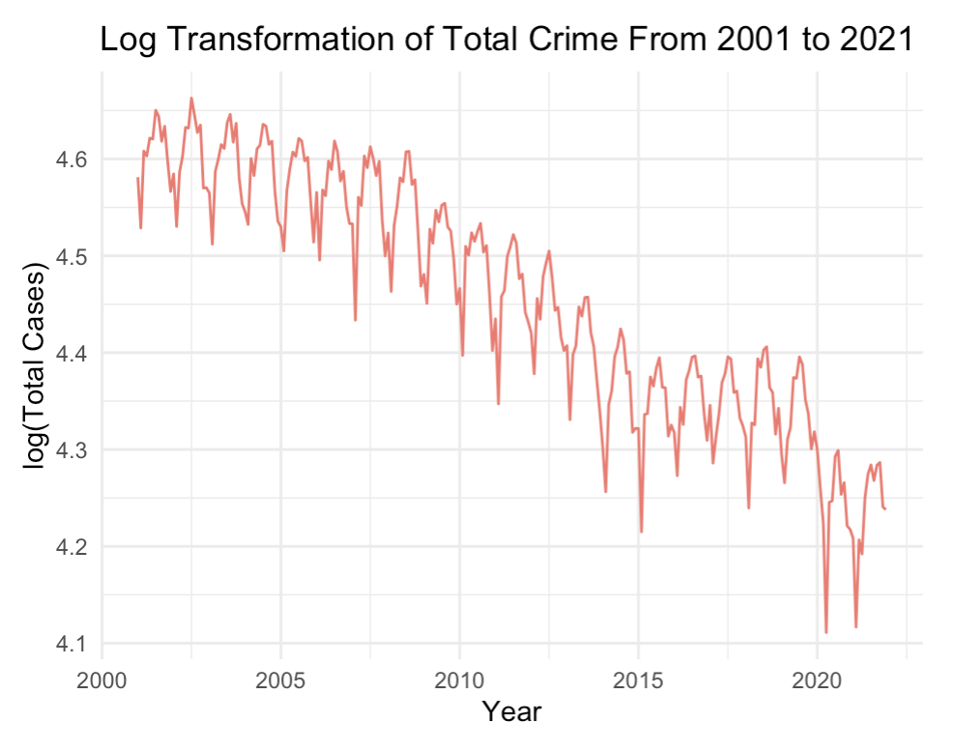
Crime Trend
Trend and Seasonal Patterns: The time series data exhibits a clear overall downward trend from 2001 to 2021 with the presence of monthly seasonal patterns.
Variance Stabilization: The original total crime data shows unstable variance before and after 2015. Log transformation helps to stabilize it into the same level.

Slide 9
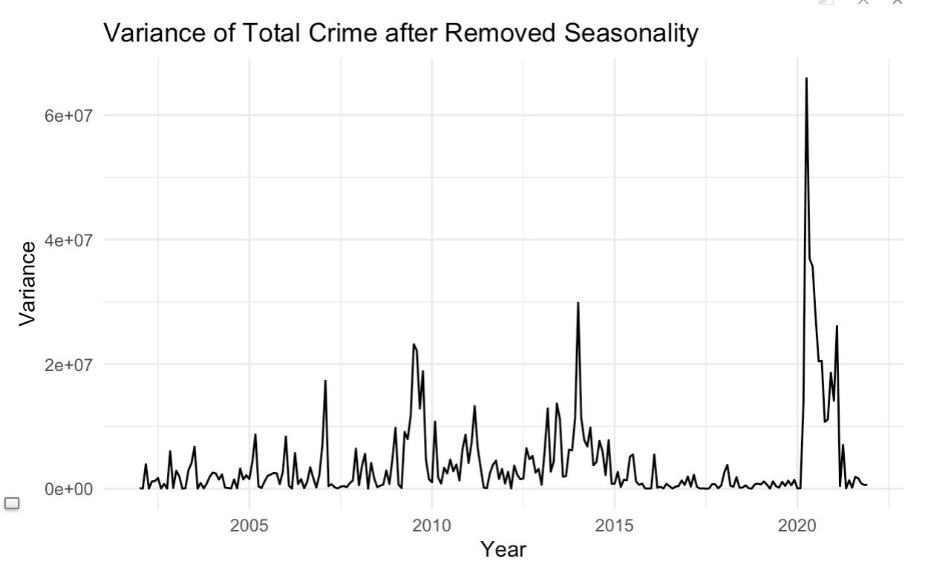
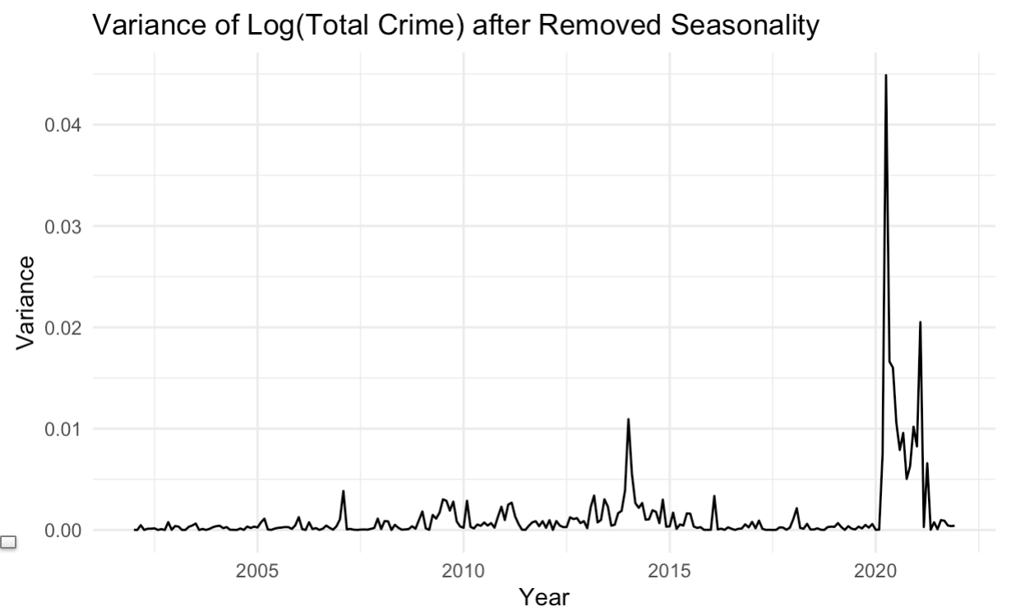
Variance of Total Crime
After applying a log transformation, the variance has stabilized significantly. However, some spikes still remain. The most notable spike occurred in 2020 due to the impact of COVID-19, which caused a sudden drop in the total number of crime cases.

Slide 10
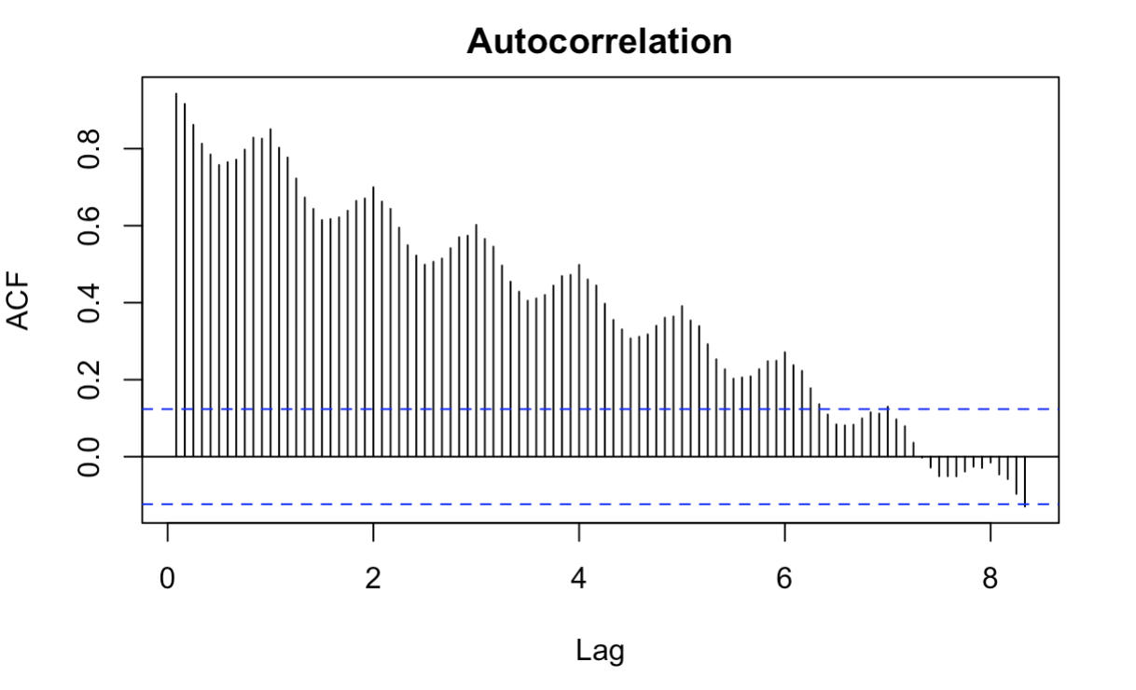
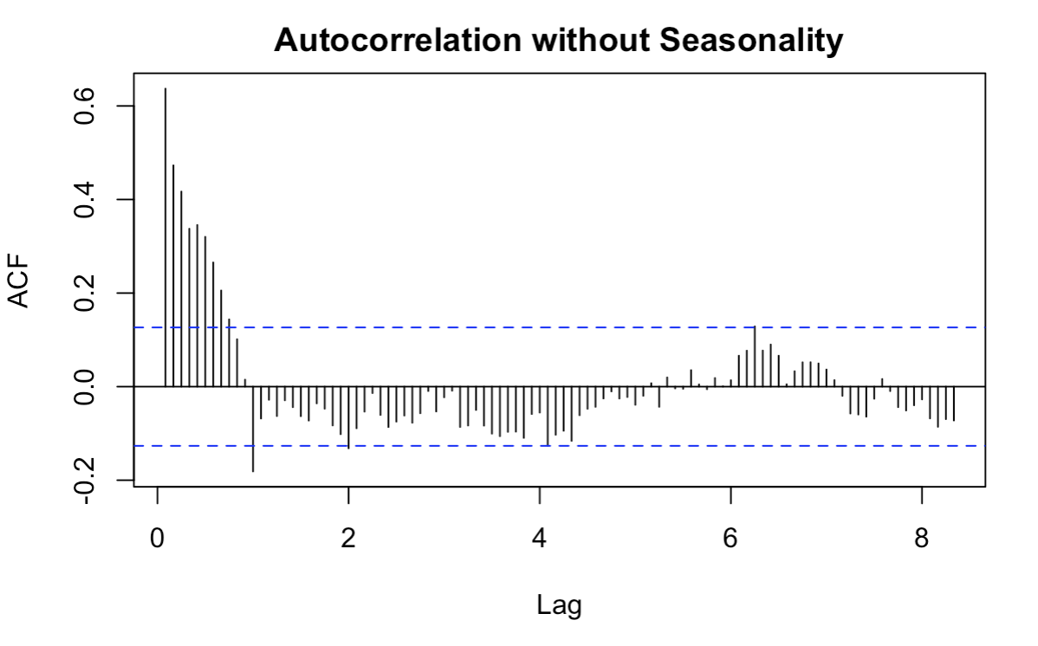
Stationarity and Correlations
Total crime shows a clearly seasonality when look at the ACF plot.
After removed seasonality, ACF plot shows stationarity of the dataset, which also be proved by KPSS test.

Slide 11
Model Selection
Seasonal Autoregressive Integrated Moving Average (SARIMA) + Intervention
Exponential Smoothing (ETS)
Holt Winters
Hierarchical Time Series (HTS)
Bayesian Structural Time Series (BSTS)

Slide 12
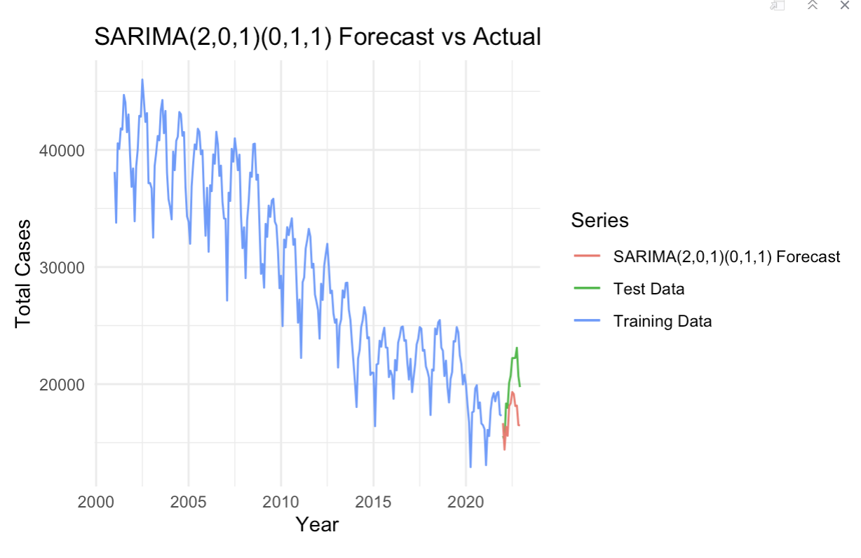
SARIMA
First Step: Use auto.arima as the baseline methodology to select SARIMA model, where ARIMA(1,0,2)(0,1,1)[12] with drift was selected.
Second Step: Iterate over p, q, P, Q parameters to select the best SARIMA model, where ARIMA(2,0,1)(0,1,1)[12] was selected.
RMSE | sMAPE
3004.72 | 0.1451
The forecasting is not good as expected. We will check the residual plot to identify any potential missing components.

Slide 13
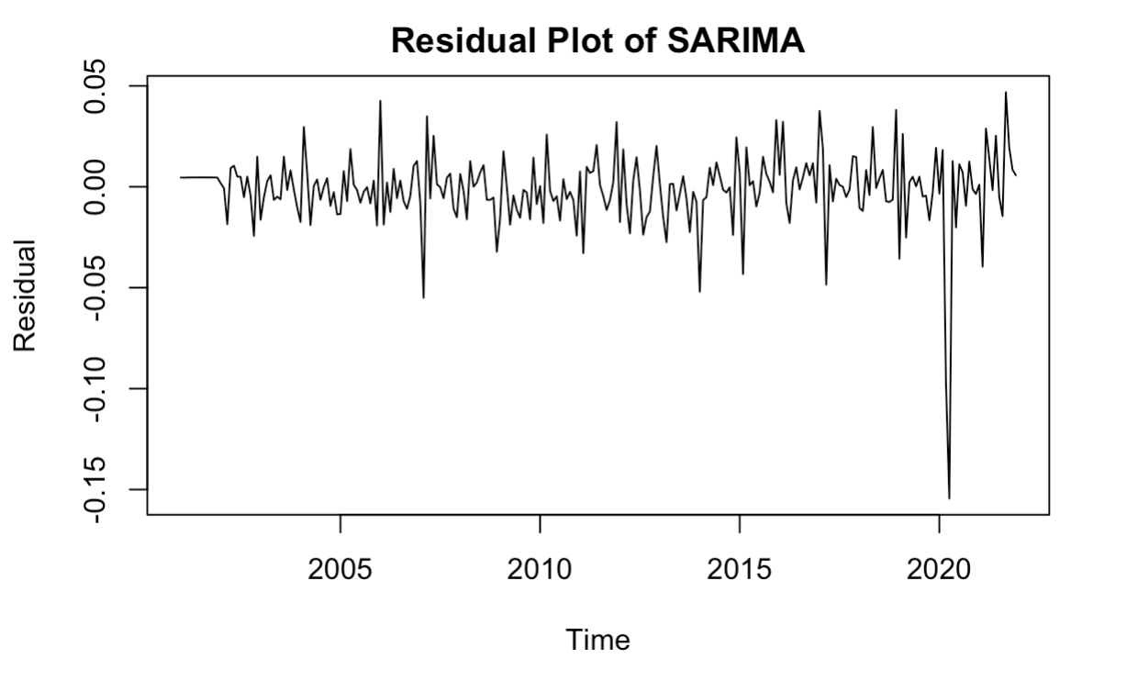
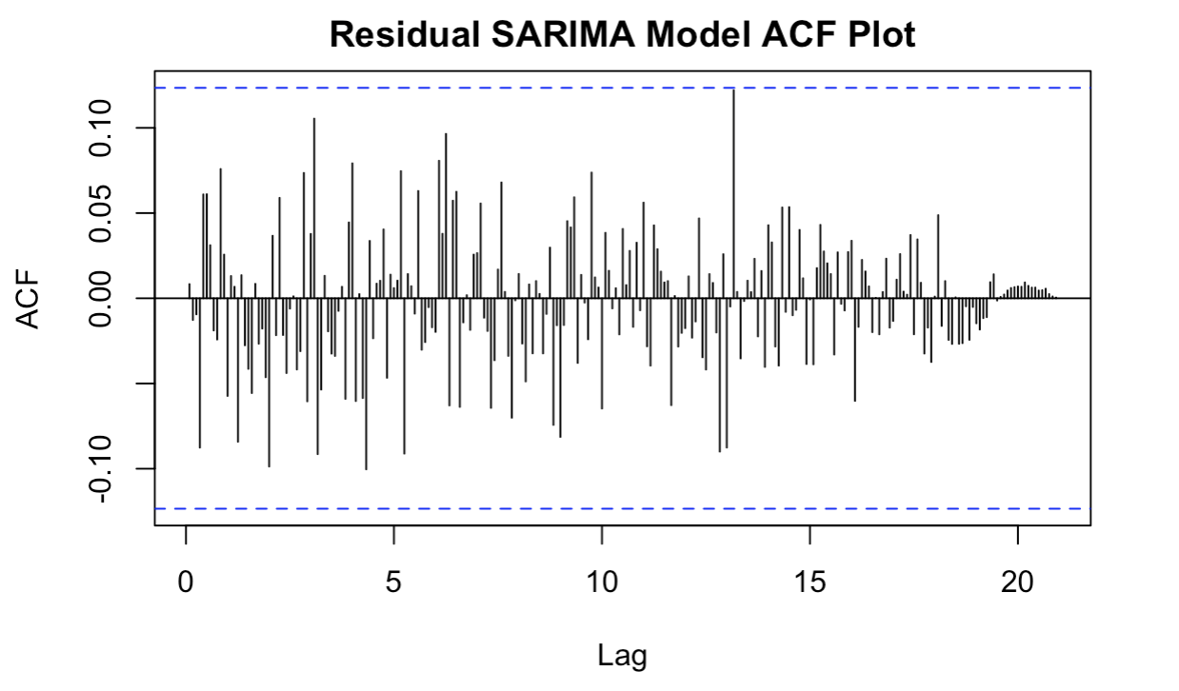
SARIMA
After checked the residual plot and its ACF plot, we can conclude that there is
no autocorrelation in residuals, which is similar to white noise. However, a dramatic decline caused by COVID-19 suggests the need for an intervention analysis.

Slide 14
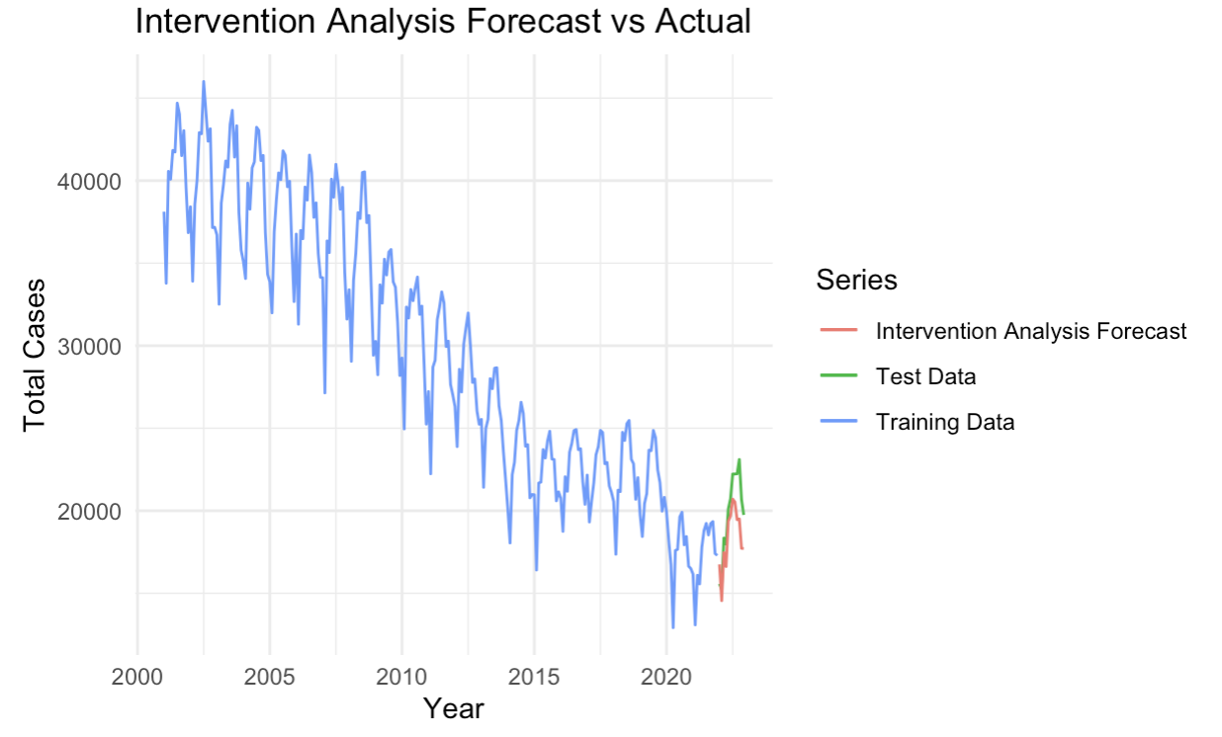
SARIMA + Intervention
Use ARIMA(2,0,1)(0,1,1)[12] before and after the intervention.
Add pulse intervention at the time Covid happened. We assume Covid impact will not last forever.
RMSE | sMAPE
1934.71 | 0.0875
Adding intervention term indeed helps crime predictions, which displays better performance compared to SARIMA.

Slide 15
Exponential Smoothing
Seasonal decomposition:
Step 1: Perform Seasonal Decomposition using Additive and Multiplicative Models
Step 2: Compute the standard deviation of the seasonal component from two decompositions
Step 3: Conclude that the type of seasonality is multiplicative
The conclusion helps decide to use ETS model with multiplicative seasonality
 | Additive | Multiplicative
Sd. | 2545.75 | 0.09

Slide 16
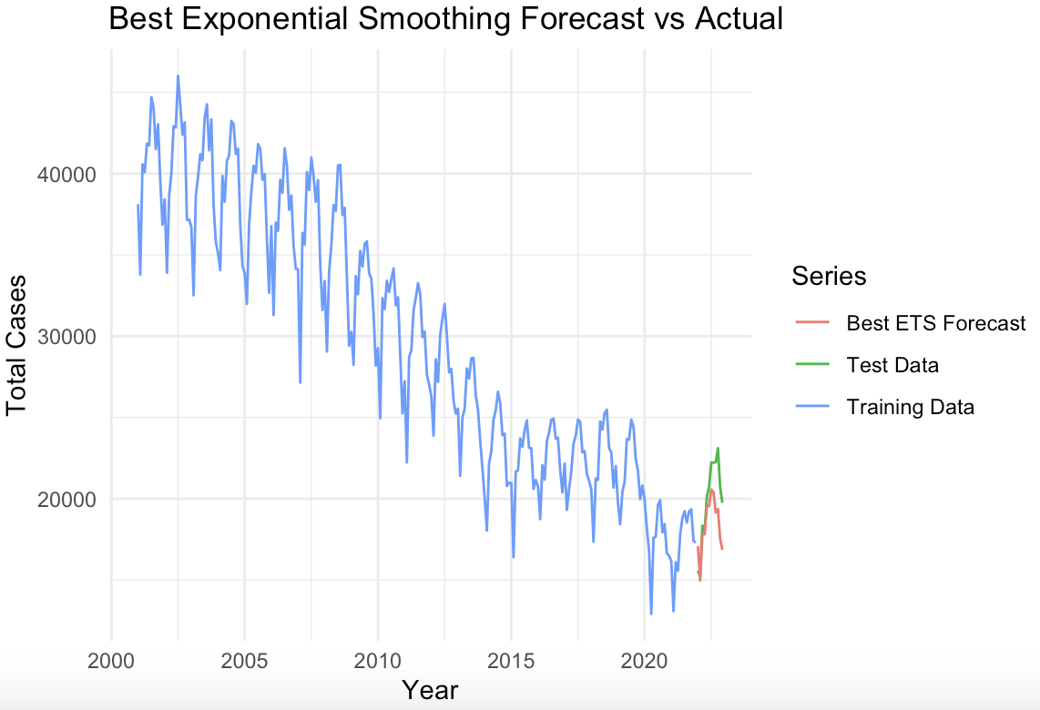
Exponential Smoothing
Considered models:
MAM: Multiplicative errors, additive trend, and multiplicative seasonality.
MMM: Multiplicative errors, Multiplicative trend, Multiplicative seasonality.
Final Model:
MMM model with lowest RMSE and MAE
 | RMSE | sMAPE
MAM | 2096.47 | 0.0880
MMM | 2090.74 | 0.0872

Slide 17
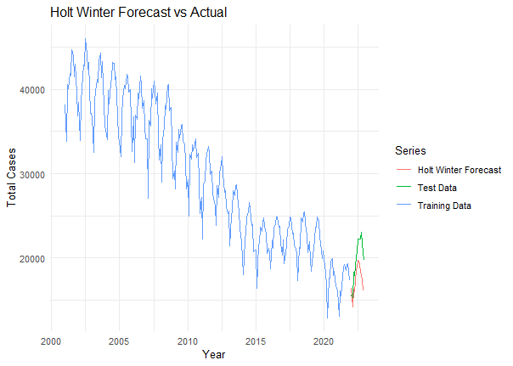
Holt Winters Multiplicative Seasonality with Trend
Suitable for non-stationary data
An extend of exponential smoothing to capture trend and seasonal
The parameters (alpha, beta, gamma) provide insights into the level, trend, and seasonality
RMSE | sMAPE
2918.20 | 0.1379

Slide 18
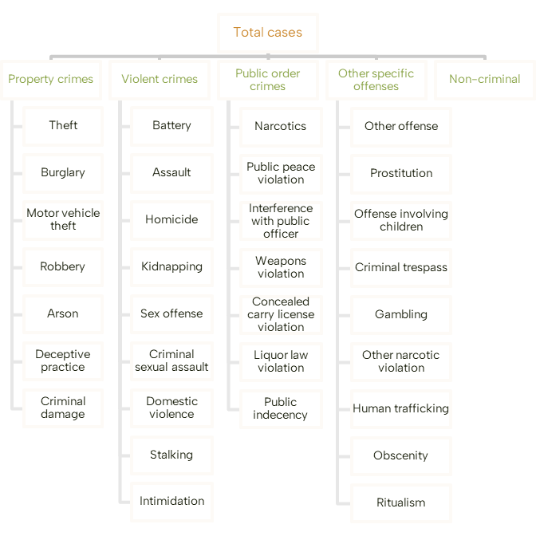
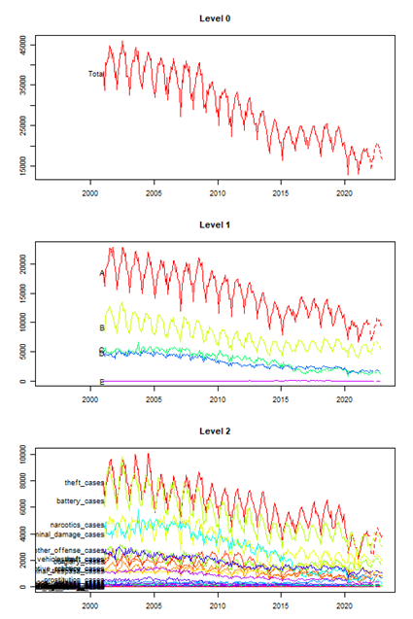
Hierarchical Time Series (HTS)
Level 0
Level 1
Top level:
most aggregated (total cases)
Bottom level:
least aggregated (specific crime case types)
Aggregate forecasts from lower levels can refine the top-level forecasts and vice versa
Level 2
Tree structure: Hierarchy of time series data

Slide 19
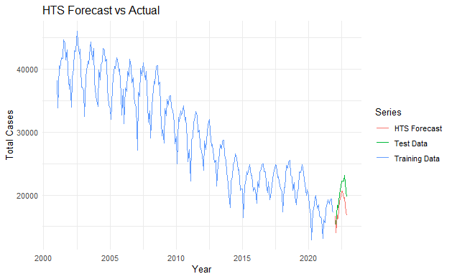
HTS - Forecasting
RMSE | sMAPE
2163.34 | 0.1037
* Allocate resources effectively to address crime in different districts and types of crimes.

Slide 20
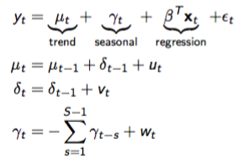
Bayesian Structural Time Series (BSTS)
Flexibility and Transparency: we can handle and visualize the underlying components, e.g. trend, seasonality, regression
Incorporating External Variables: Allows the inclusion of external predictors like weather, holidays, and socioeconomic factors.
Handling Uncertainty: Ability to incorporate uncertainty into our forecasts so we can quantify future risk.
Notes:
Why BSTS?

Slide 21
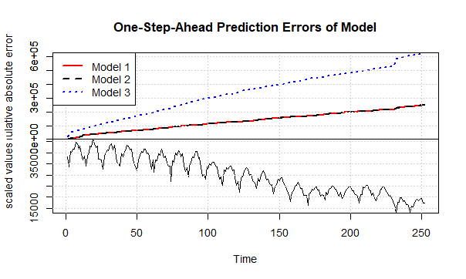
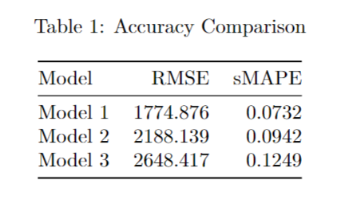
BSTS - Model Comparison
State Components:
Model 1: Trend + Monthly Seasonality
Model 2: Trend + Monthly Seasonality + Regression (with unemployment rate)
Model 3: Dynamic regression (with unemployment rate)
The additional predictor - the unemployment rate - used to fit Models 2 and 3 did not produce additional predictive accuracy.
Model 1 has the lowest RMSE and sMAPE.

Slide 22
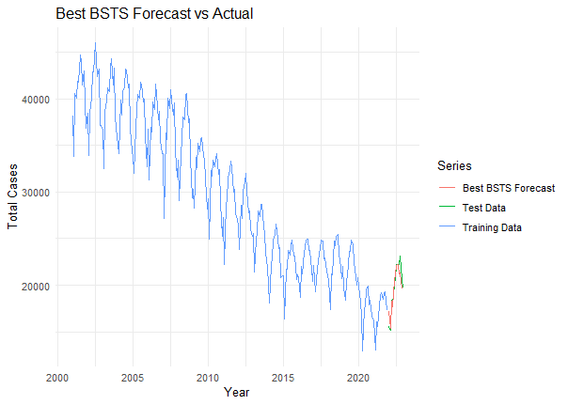
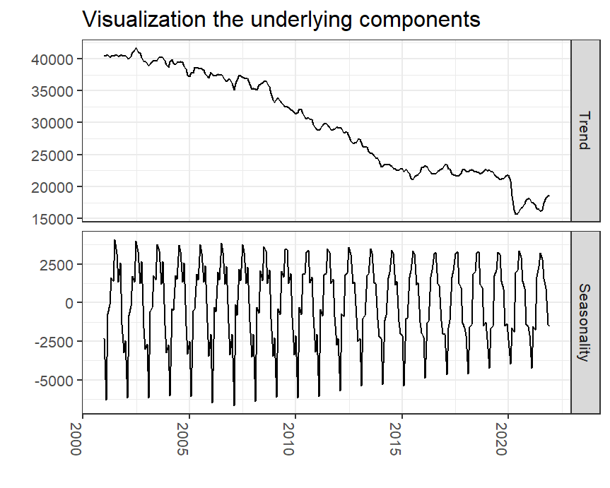
BSTS - Forecasting
Final Model: BSTS with Trend and Monthly Seasonality State Specification
Notes:
The left graph shows the predictions of the final model, which closely match the actual data.
The right plot clearly shows the seasonal pattern of crime cases as well as how the total number of crimes has declined over this period.

Slide 23

Model Comparison
 | RMSE | sMAPE
SARIMA | 3004.72 | 0.1451
SARIMA + Intervention | 1934.71 | 0.0875
Exponential Smoothing | 2090.74 | 0.0872
Holt Winters | 2918.20 | 0.1379
HTS | 2163.34 | 0.1037
BSTS | 1774.88 | 0.0732

Slide 24
Future Steps
Explore the inclusion of additional variables such as demographic data and other social indicators to further improve the forecasting accuracy.
Gather additional historical data to enhance the robustness of future predictions.
Explore and implement other forecasting models to compare performance and improve accuracy.

Slide 25
Thank you

Slide 26
Github
https://github.com/marian2216/ADSP31006-Crimes-in-Chicago.git

